Slide 1

Towards real world
federated learning
Project 2 @ Machine Learning and Deep Learning 2023
Teaching Assistants: Debora Caldarola & Eros Fanì
debora.caldarola@polito.it - eros.fani@polito.it

Slide 2
Deep learning models are data hungry
OpenAI used 570GB of data to train ChatGPT - around 300 billions words - taken from text databases from the internet
ChatGPT: Everything you need to know about OpenAI's GPT-3 tool. Science Focus.

Slide 3
Huge amounts of data come from the edge today

Slide 4
4.7 BILLION
Photos taken per day in 2022
92.5%
Taken with smartphones
2,100
Pictures on each user’s smartphone on average
Photutorial. Number of Photos (2022): Statistics, Facts, & Predictions

Slide 5
But most of this data is privacy protected!

Slide 6
Federated learning
New distributed framework introduced by Google to learn from privacy-protected data without breaking regulations
Client-server architecture
The clients’ data never leaves their devices
Standard federated training

Slide 7
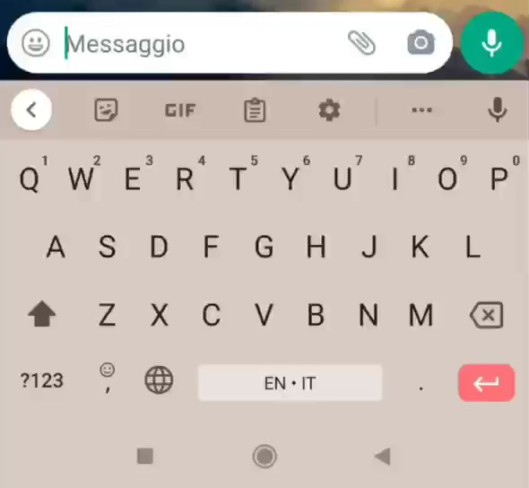
In our daily life

Slide 8
In our daily life
What happens if users have different ways of typing messages, e.g. in their use of emojis, of the suggestions, of the GBoard itself, of abbreviations?

Slide 9
In our daily life
What happens if users speak differently, e.g. distinct voices, speeds, slangs?

Slide 10
Can we still learn a good model when the data distribution is heterogeneous?

Slide 11
Towards realistic scenarios
What if pictures are taken with different weather or light conditions, i.e., domains? What happens when there are visual domain shifts?

Slide 12
Towards realistic scenarios
LABELLING DATA IS COSTLY and often requires DOMAIN EXPERTISE
What happens if we remove the constraint of having labelled data on the client-side?

Slide 13



Project 2
towards real world federated learning
Goal: to become familiar with the federated scenario and address its main challenges when moving towards the real world.
X
Heterogeneous data distribution
Generalization to different and possibly unseen domains
Unlabelled data
on the client-side

Slide 14
Project 2
towards real world federated learning
TRACK 1
Task: image classification on numbers and digits written by users having different handwriting
Federated challenges:
Data heterogenous distribution
Domain generalization
Personal contribution
TRACK 2
Task: semantic segmentation for autonomous driving
Federated challenges:
Data heterogenous distribution
Unlabelled data on the client-side
Personal contribution

Slide 15
From previous years
FedSeq: an algorithm proposed to address data heterogeneity in FL by a group in this course
… which led to a first publication @ International Conference on Pattern Recognition 2022 in Montréal
… which led to 2 Master’s theses
… which led to a journal extension, soon to be published!

Slide 16
Good luck!
For any additional questions:
Debora Caldarola debora.caldarola@polito.it
Eros Fanì eros.fani@polito.it

